Slide 1
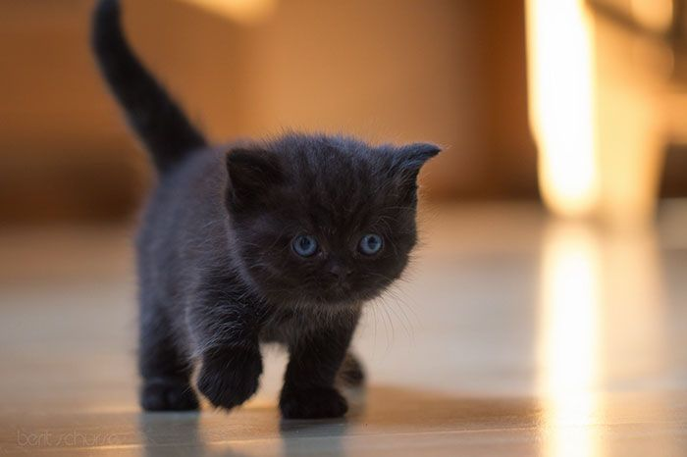

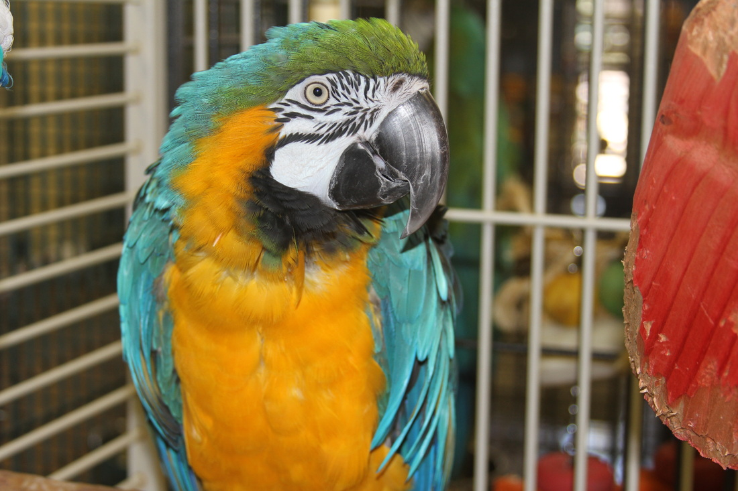
Animal Shelter Project
By Anastassia Tarassova (1277712)
and
Dang Huynh Minh (1670214)

Slide 2
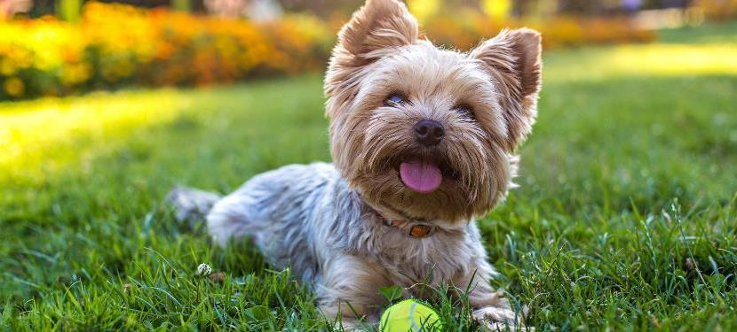

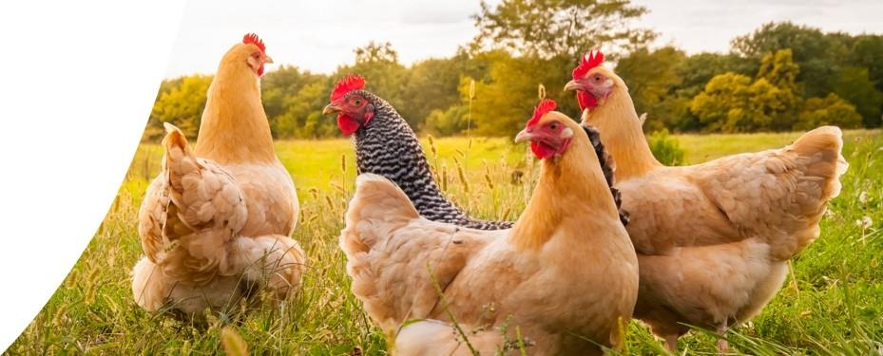
Presentation Structure
Why the Project
First Iteration
Current Iteration
SOLID, Design Patterns, MVC, Three-Tier
Unit Testing
Potential Improvements

Slide 3
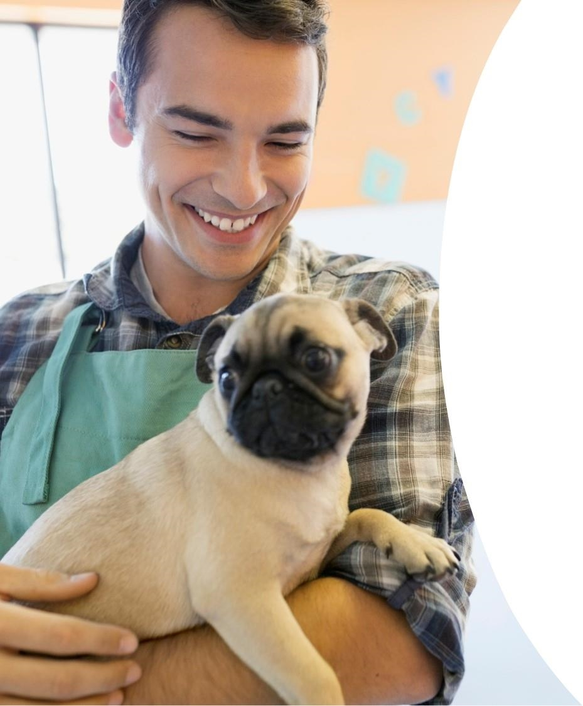
1. Why Animal Shelter?
Continuity of past course
Real-life application
Multitude of designs
Cute!

Slide 4
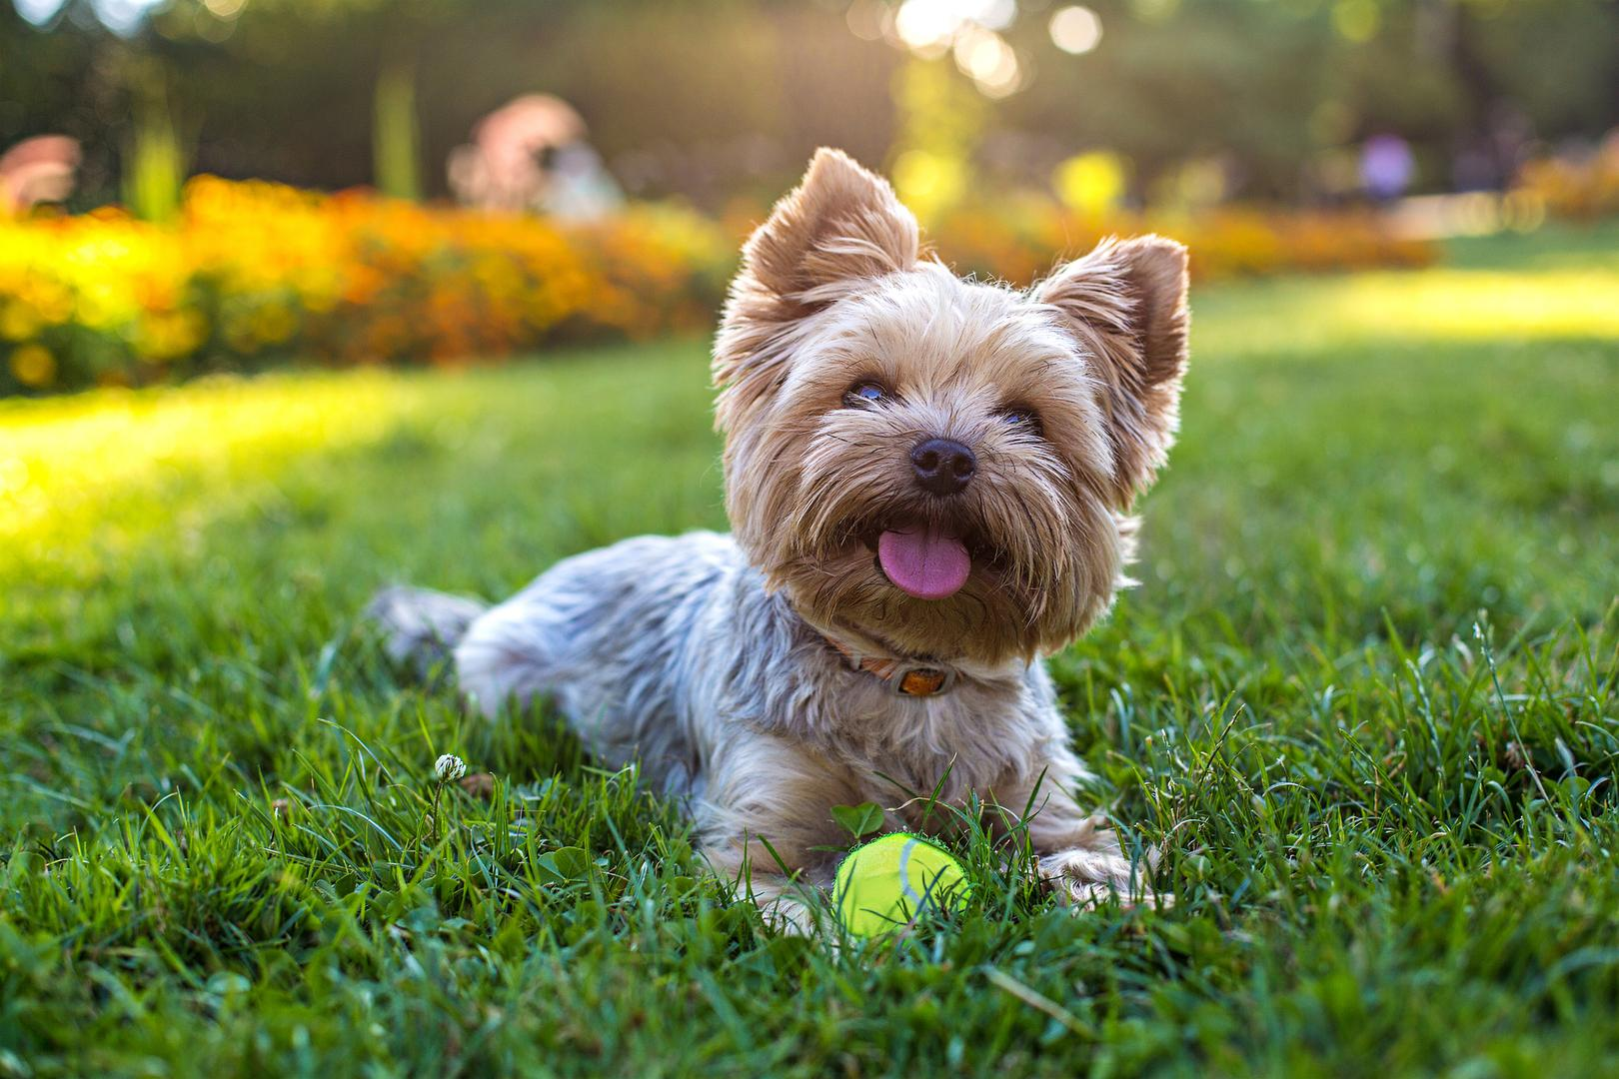
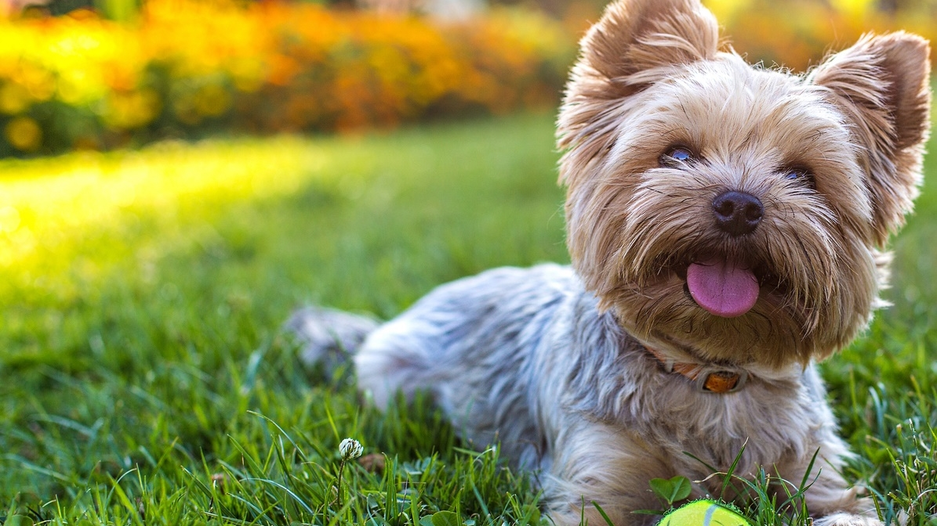
2. First Iteration (Java III course)
extensive UML
multitude of classes
three user roles planned
(Admin, Volunteer, Vet)

Slide 5
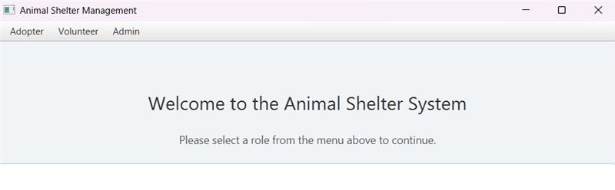
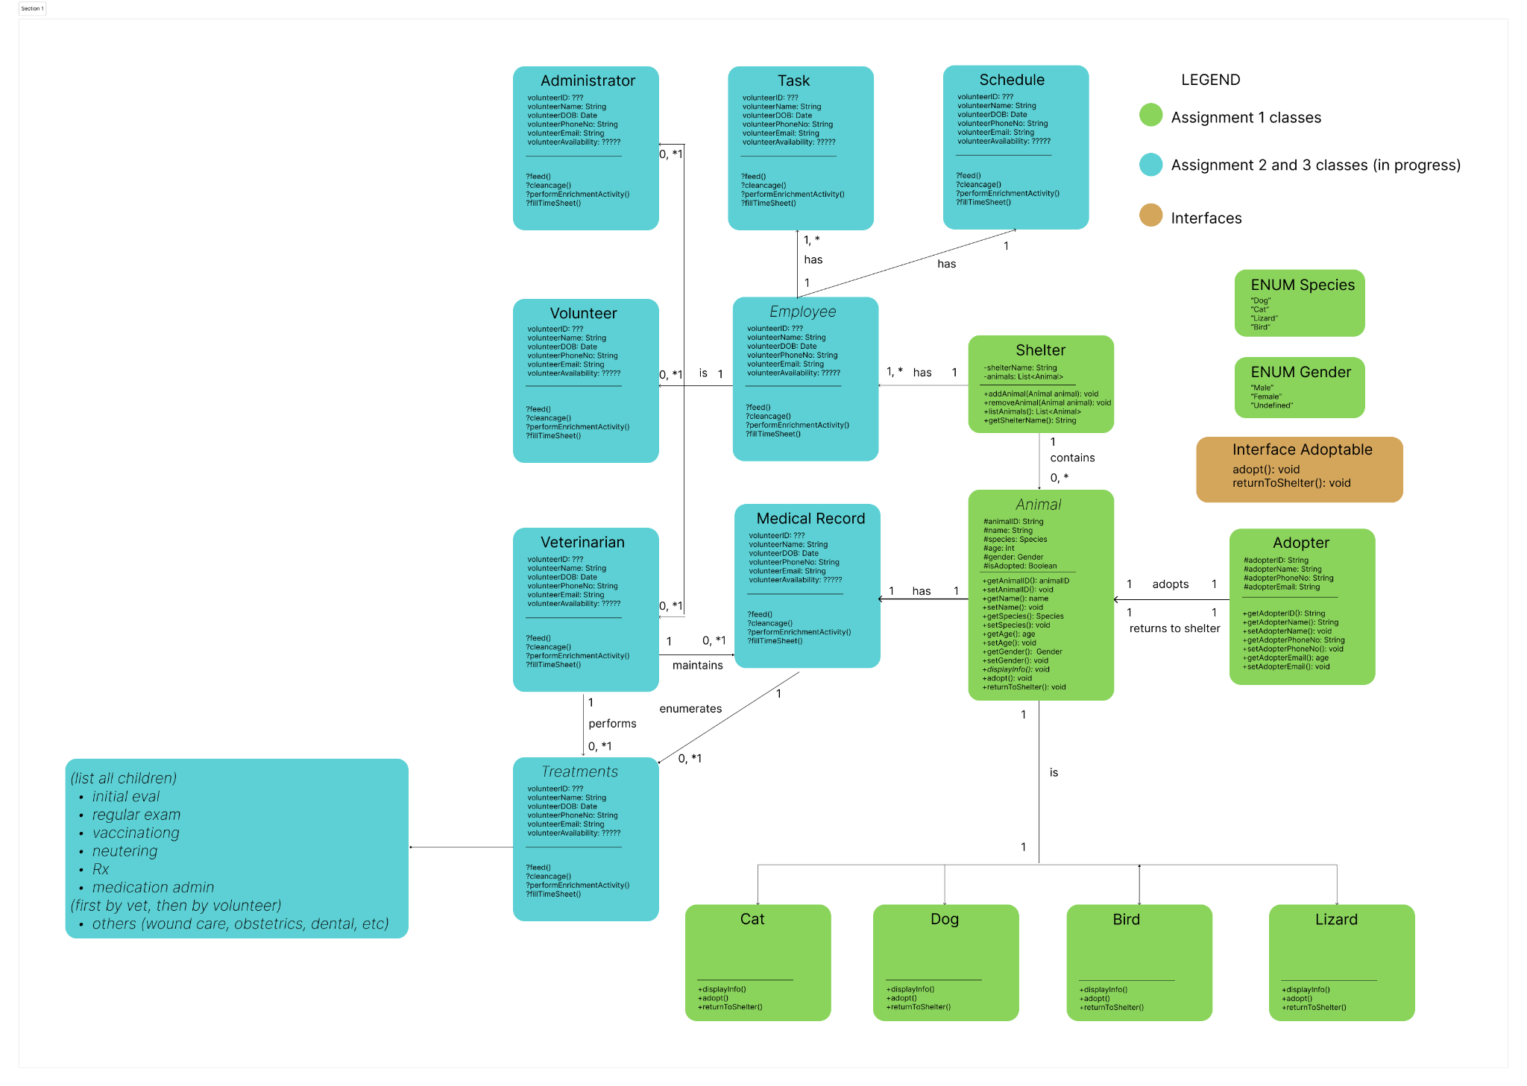
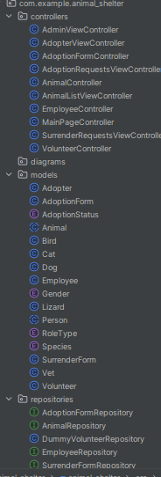
First Iteration

Slide 6
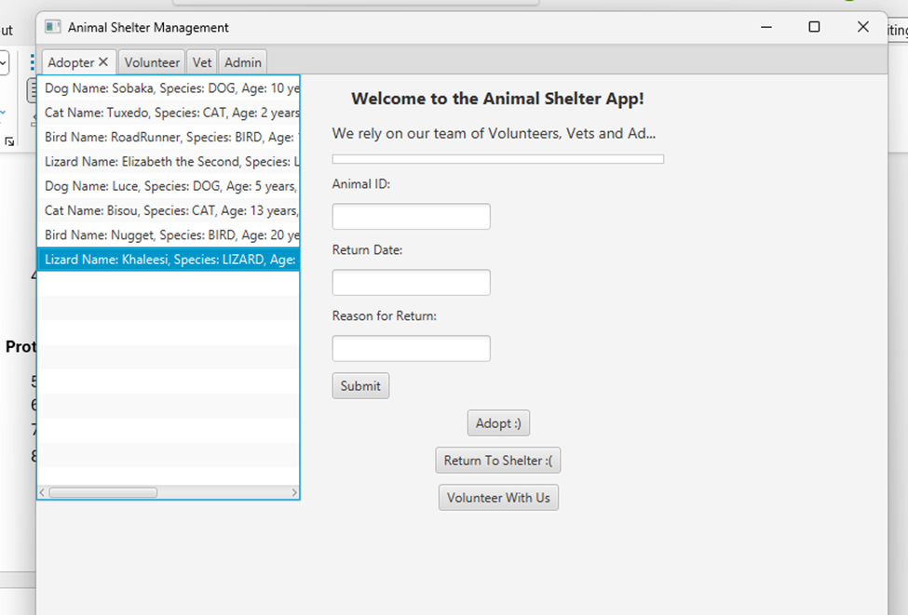
First Iteration
Pros:
Ambitious
Abstract classes galore
Realistic user stories
Cons:
Structural issues (not SOLID)
Repetition (not quite DRY)
Incomplete logic (very little design patterns)
No automated testers

Slide 7
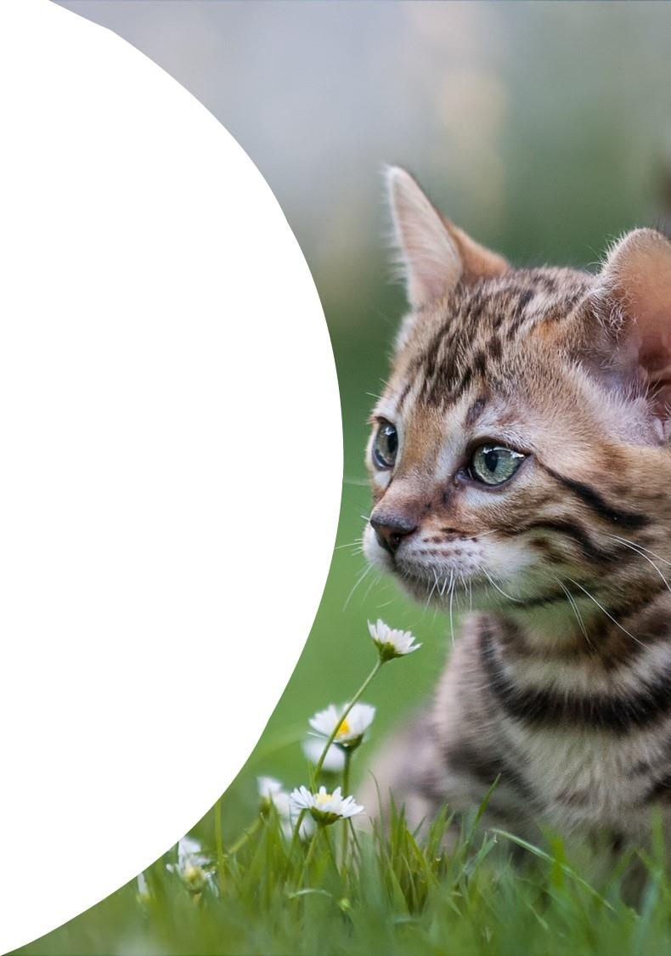

3.Current Iteration with
Data Structures and Algorithms
3. Current Iteration (Data Structures and Algorithms)
extensive UML
multitude of classes
CLI and JavaFX friendly architecture
……………

Slide 8
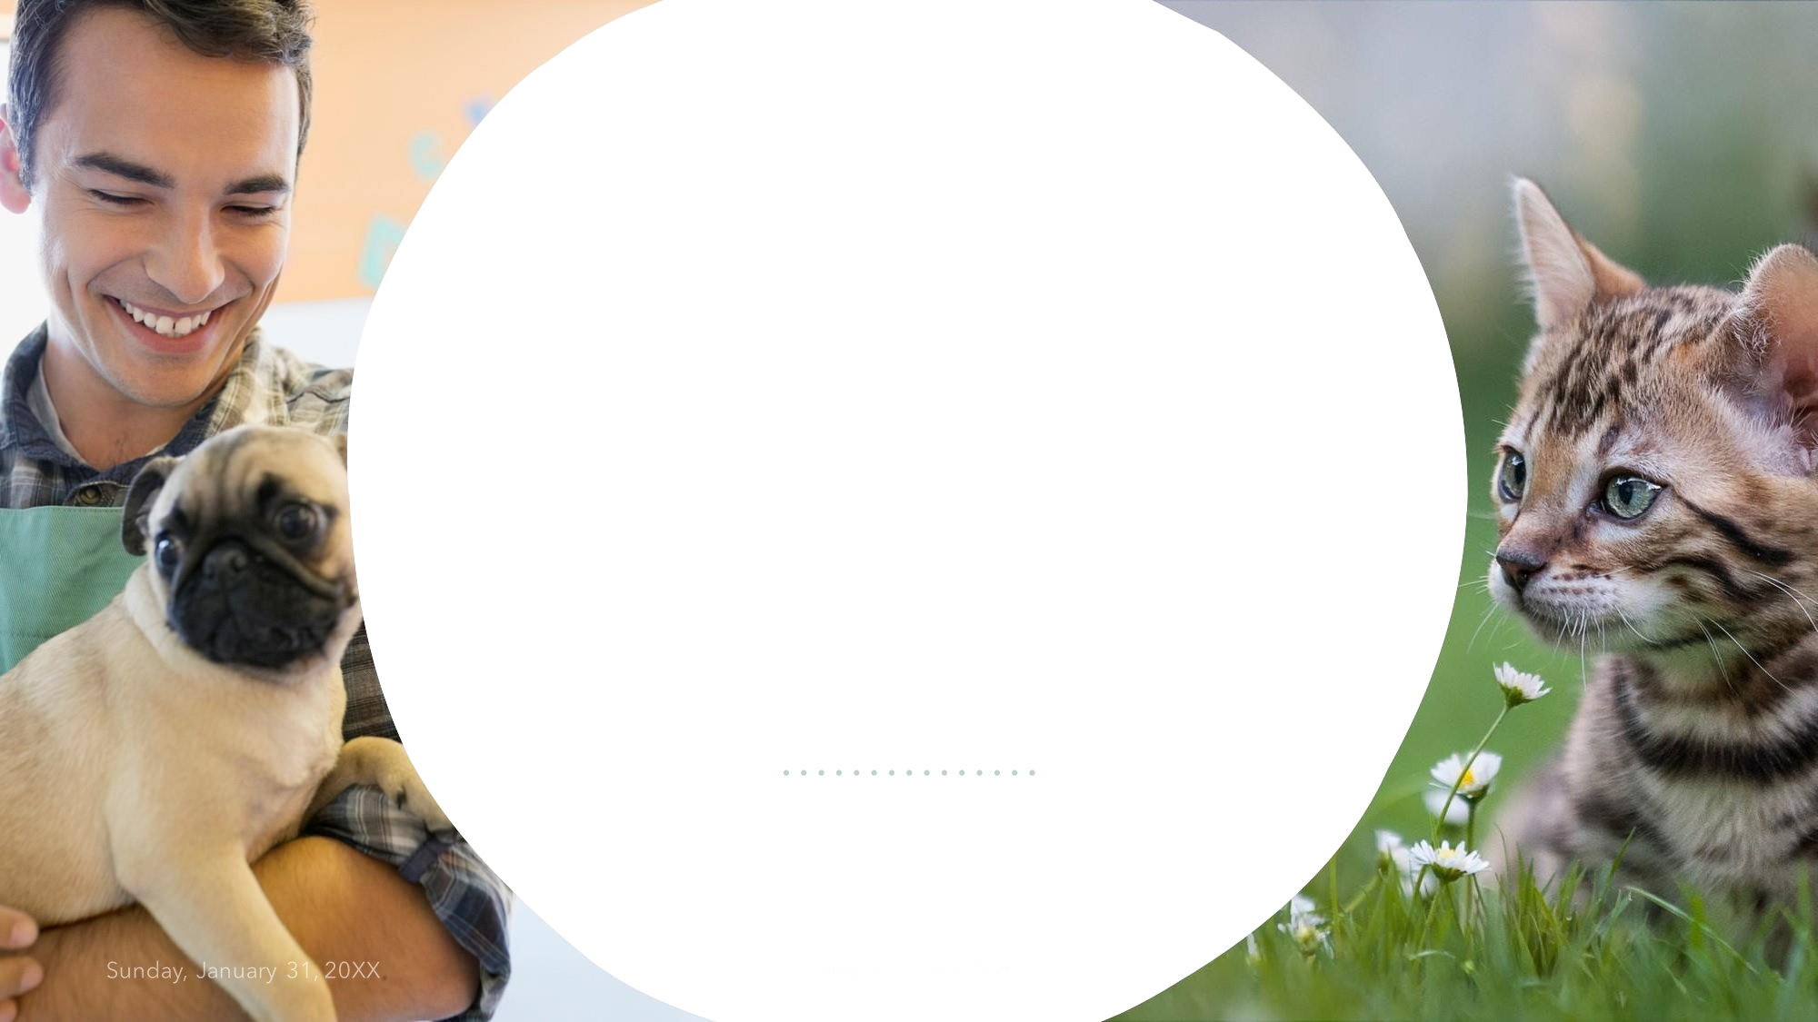
4. Is it SOLID?
S: Extensive use of Controllers and Models (e.g. MAnimalController, MedicalRecordController, etc.) O: Using inheritance, Builder, Strategy, Factory DPs
L: Child methods override Parents, Decorator DP used I: Interfaces like Adoptable, Treatable…
D: (could be improved) - controllers hardcode Scanner (tight coupling)
solution: Scanner injection
more Interfaces to implement
solution: Interfaces for all Services

Slide 9
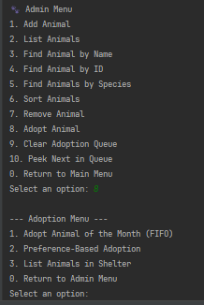
Did you use data structures?
ArrayList <Animal>:
good random access and iteration
Queue <Animal> (Shelter Queue)
FIFO adoption, task queues…
HashMap <String, Animal>
looking up animals by String id
List <String> for MedicalRecord
listing check-ups, vaccines, treatments

Slide 10
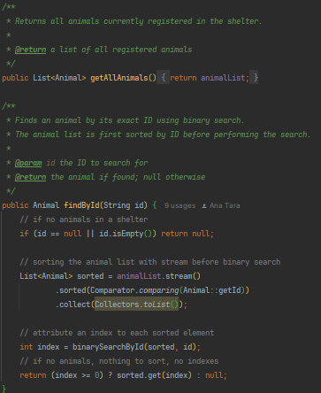
What about algorithms?
search by name: linear scan over list ( O(n) ) + binary
search by id: currently linear (also O(n), could be improved with a Map)
sorting: Java’s built-in sort() with custom comparators for name and age
AnimalRegistry.java

Slide 11
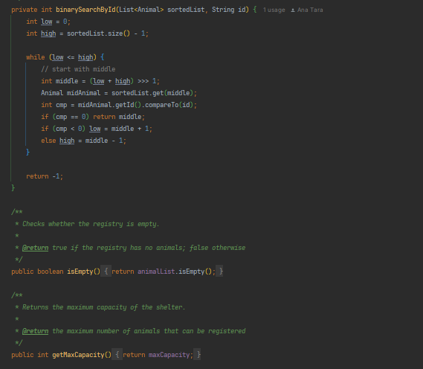
Binary Search by Id
AnimalRegistry.java (cont.)
Best case:
can be O(1) if we land directly on searched Animal
Worst case:
can be O(logn) because of call stack from recursive search
until Animal found

Slide 12
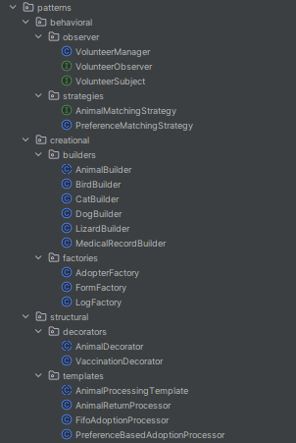
Algorithms (cont.)
FIFO: enqueue/dequeue
prompt validators: basic loops for checking booleans/numeric inputs (in Animal Controller)
builders: not quite an algorithm, but contributes to their efficiency

Slide 13
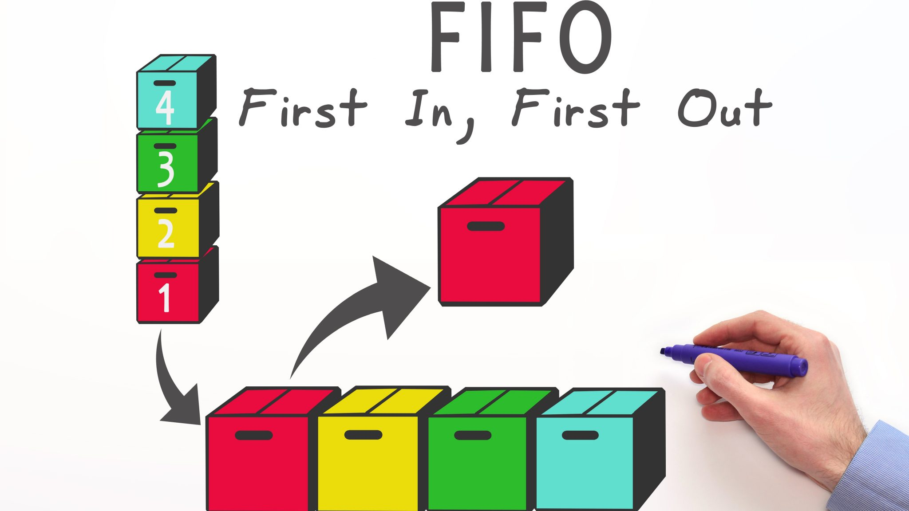
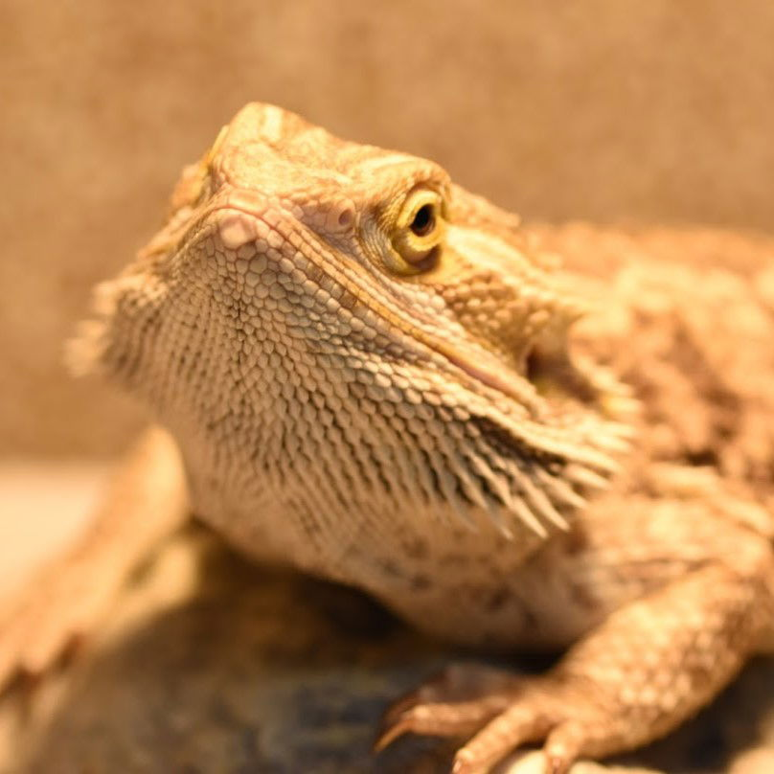
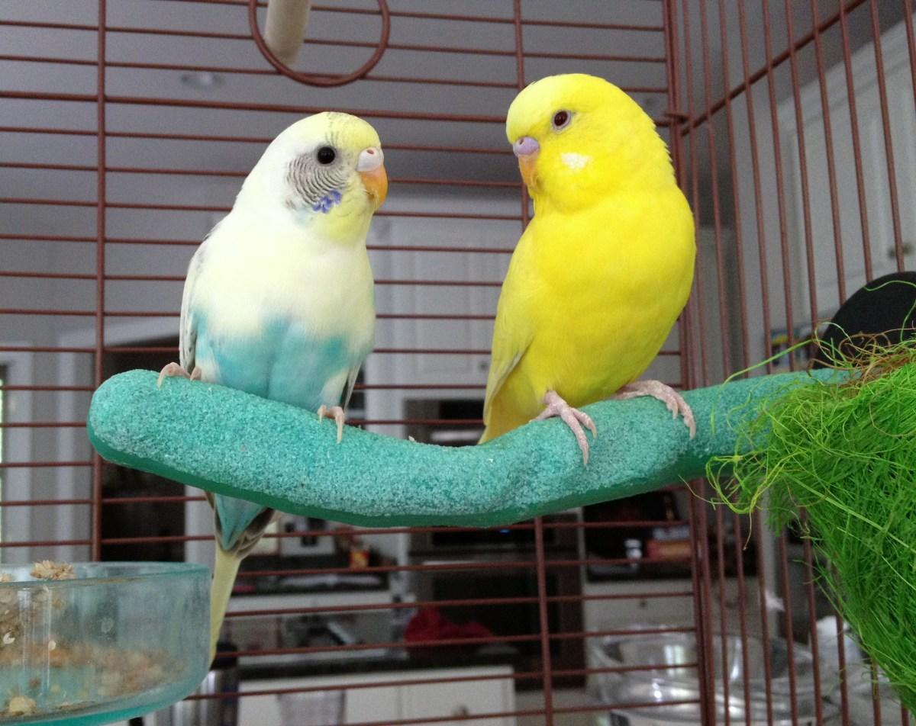
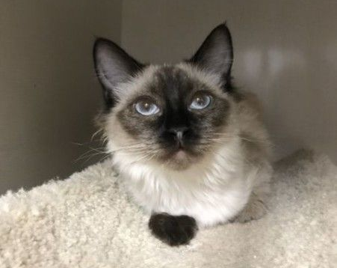
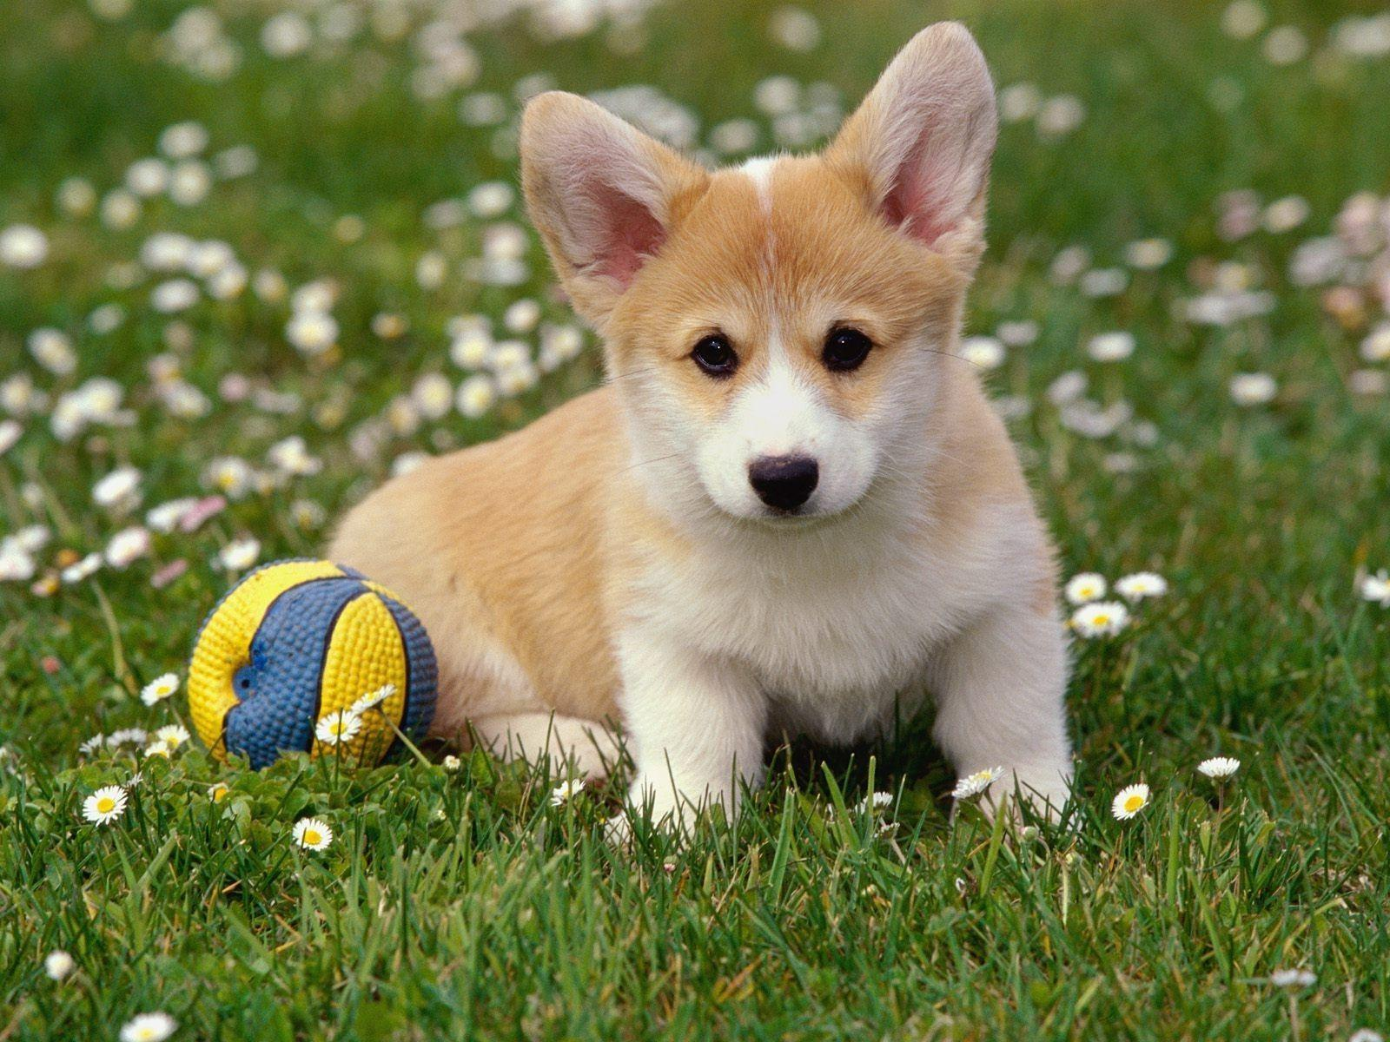
Marketed as
Animal of the Month
Notes:
diagram taken from https://fmcgmanagement.ro/wp-content/uploads/2019/07/13-shutterstock_425567284_mic-2048x1152.jpg

Slide 14
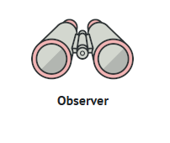
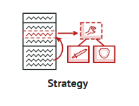
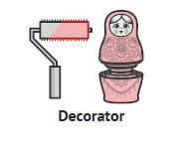
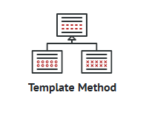




Design Patterns Used
Behavioral
Structural
Observer New arrivals signaled to:
- Volunteers
- Vets
- Admins
…
Strategy Adoption strategies for:
- Animal of the Month
- Preferred Animal
…
Decorator - Animal decorator
- Vaccine decorator
Template
- FIFO adoption
- Preferential adoption
…
Notes:
all images taken from https://refactoring.guru/design-patterns/catalog

Slide 15
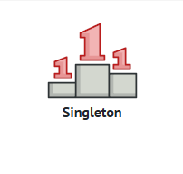
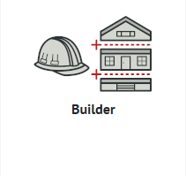
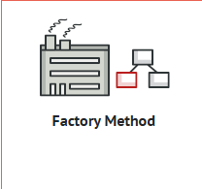
Creational
Builder
- Animal
- animal subclasses
-MedicalRecords
…
Factory
-Adopters
- Forms
- Logs
…
Singleton
Main class
Notes:
all images taken from https://refactoring.guru/design-patterns/catalog

Slide 16
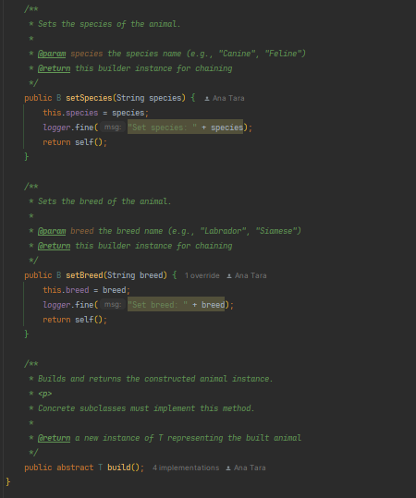
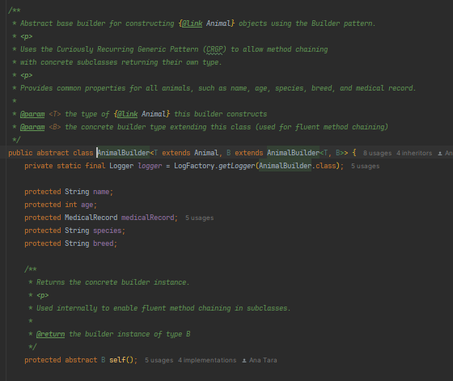
Animal Builder (abstract)
[...]

Slide 17
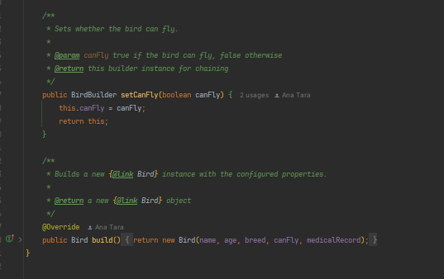
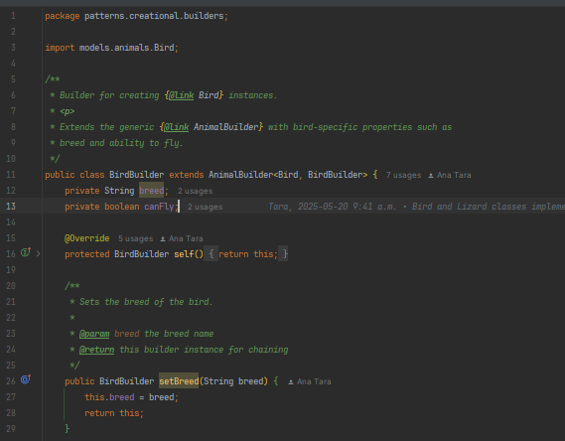
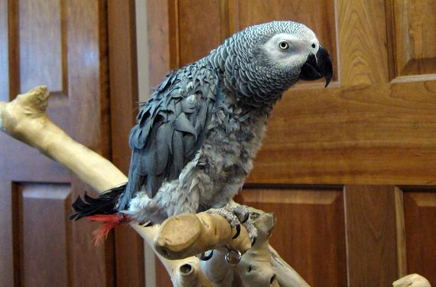
e.g. Bird builder (concrete)

Slide 18
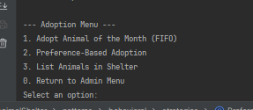
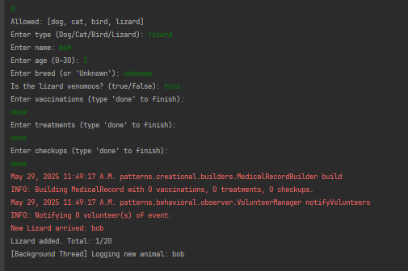
e.g. adding a Lizard

Slide 19
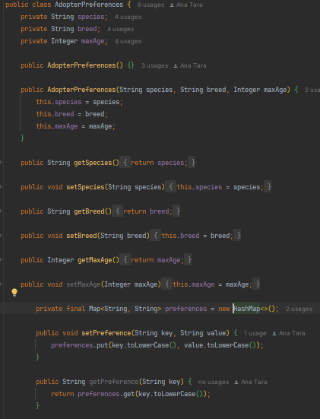
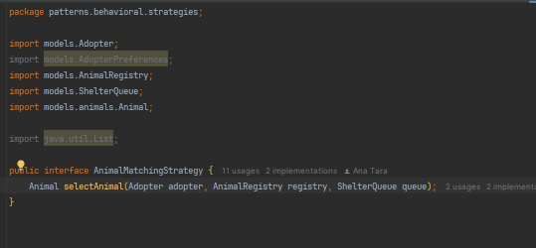
Preference-based Adoption Strategy
(Dijkstra-inspired)
AnimalMatchingStrategy.java (Interface in strategies)
AdopterPreferences.java (model)

Slide 20
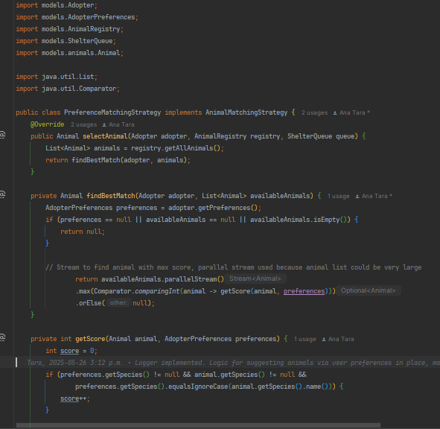
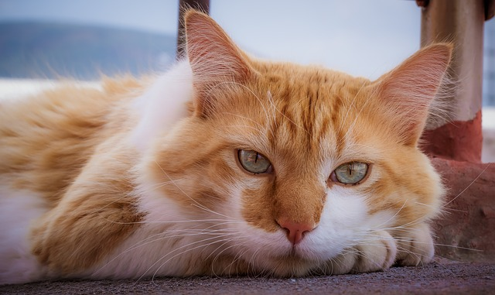
Preference-based Adoption Strategy
(cont.)
preferenceMatchingStrategy.java
[...]

Slide 21
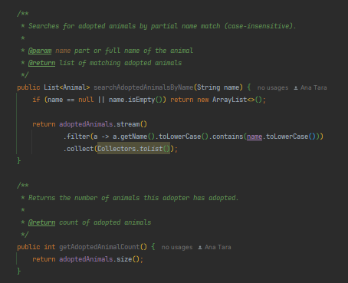
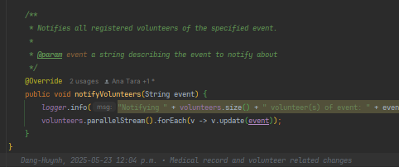
Usage of Streams and Threads
Mostly used in Controllers and Models, for the scope of this project​
Better code readability
Improves performance times
Better architecture
e.g. Adopter model
e.g VolunteerManager for Observer (parallel streams)

Slide 22
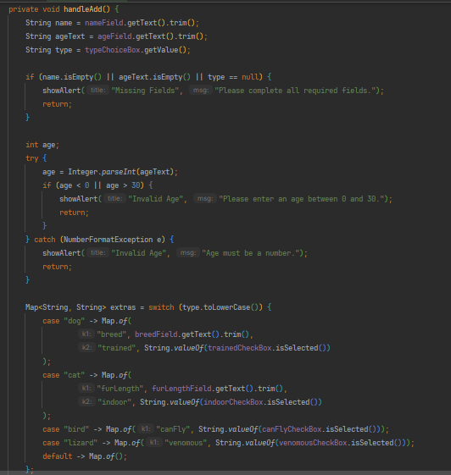
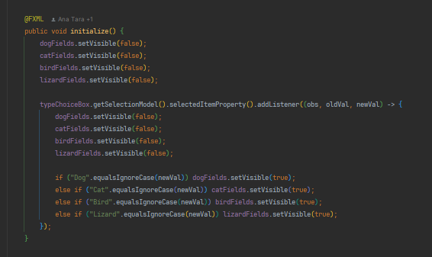
Walkthrough: adding a new animal to the shelter
AddAnimalController.java

Slide 23
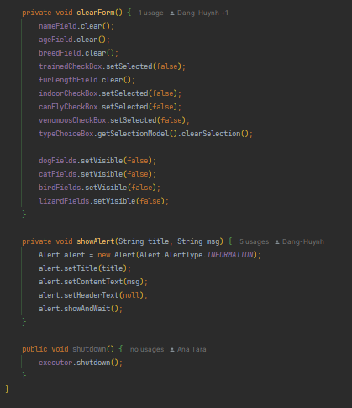
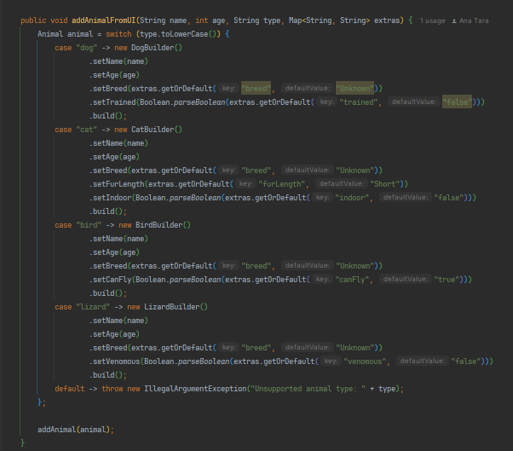
AddAnimalController.java (cont.)
AnimalService.java

Slide 24
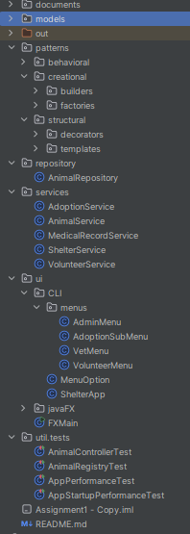
Three-Tier Architecture
Presentation layer (UI)
FXML: JavaFX UI layout
CLI: test-based interactions
Menus: Admin, Vet,Volunteer
Business Logic Layer
Controllers: for views, for objects, for processes
Services: vaccination, animal registration
Builders: controlled Object creation
Observer pattern: event handling (to be extended)
Database layer
DAO: basic CRUD (to be extended)
Repositories: for DB (to be extended)

Slide 25
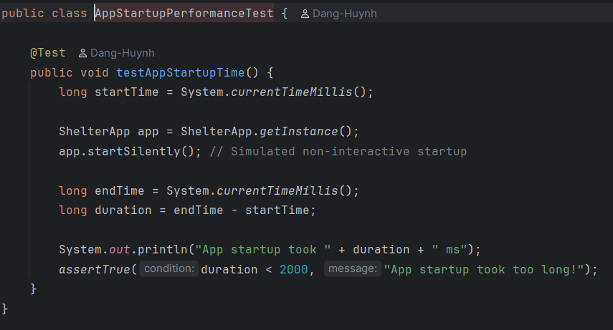
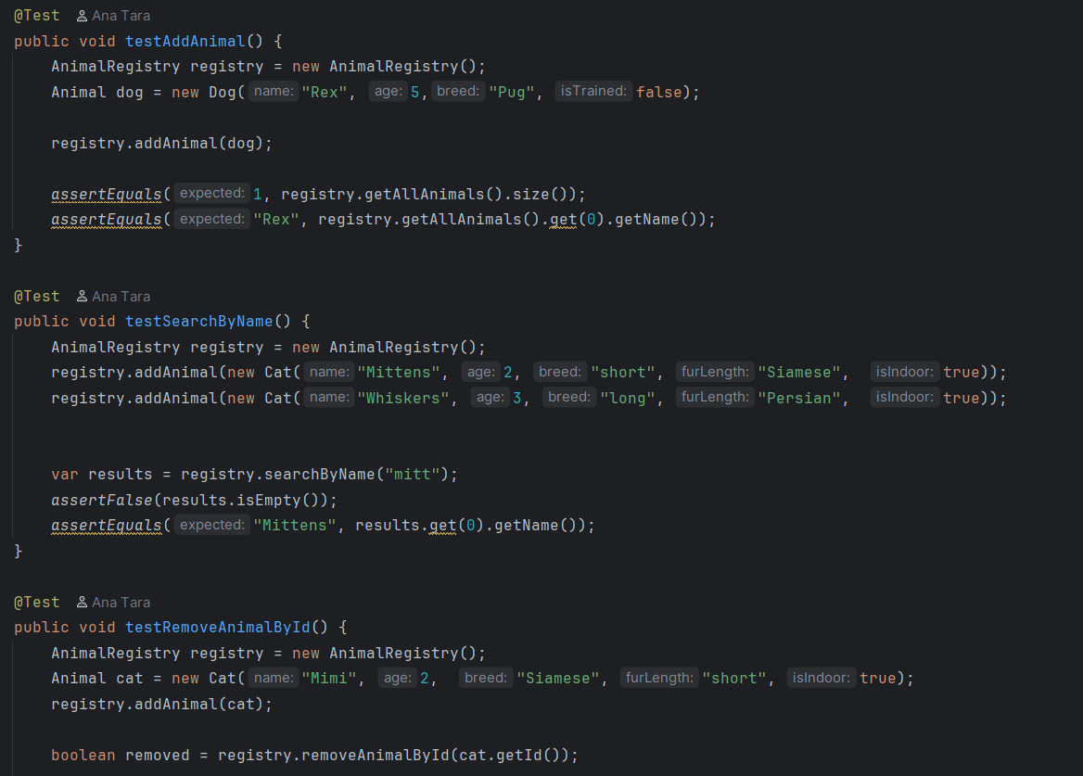
5. Testing
Performance time test for startup time
JUnit tests for logic heavy controller

Slide 26

Timeline
Rebuilding Basic Classes
project started from scratch
reused UML
Choosing Design Patterns
team discussions
online resources
tutorials
Establishing MVC structure
accent on modularity
threads
streams
Elaborating CLI/JavaFX UI
three branches: master, CLI, JavaFX GUI
Testing
JUnit tests
Mockito
Notes:
image from https://site.mockito.org/

Slide 27
6. Future Improvements
more threads once DB is connected (parallelism)
better use of design patterns (Bridge!)
elaborate Volunteer metho (track tasks, mark as done, delegate)
implement Scheduling
implement sessions (Admin, Vet, Volunteer)
refine DAO (PowerBI attempt)
finalize logging
finalize JavaFX UI

Slide 28

Summary
Animal Shelter app for employee use
Supports multiple user roles
Streamlines animal adoption, returns, care
Considers adopter preferences
for optimal pairing
Animal of the Month feature
Extensible, organized, user-friendly

Slide 29
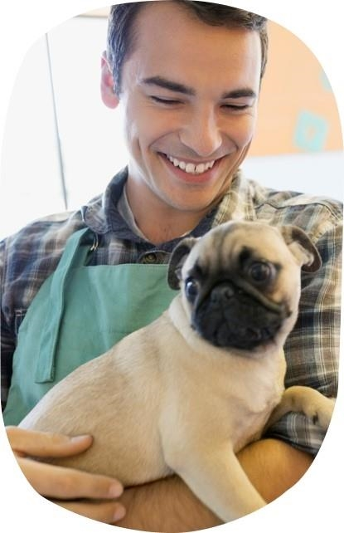



Thank you for listening!

